Slide 1


Academic streaming source for social issue and documentary film
With content from leading distributors
640+ titles
Streaming since 2012

Slide 2
Technical overview
Encoding details
Streaming details
Collection development
Licensing options
Integration + Discovery
Usage data
Additional features
Post-sales support

Slide 3
Encoding details
H.264
400 kbps, 800 kbps, 1600 kbps, 2500 kbps renditions in an .mp4 container for Flash / desktops
256 and 800 kbps in a M2TS container for HTML 5 delivery to iOS devices
Typically master file is created from producer materials (not DVD)

Slide 4
Streaming details
We partner with Brightcove, a publicly-traded leader in the video streaming world
Variable bitrate delivery
Akamai network: high performance distributed content delivery network

Slide 5
Collection development
Selectively chosen our participating distributors
Work with them to determine content to make available
Respond to requests for specific titles

Slide 6
Pricing
Per title price depends on:
Carnegie Classification
Number of titles licensed
Length of license period
For single titles, length of film

Slide 7
Licensing options
Single titles or whole collection
One week, one semester (110 days), one year, three years, or Life of File
Tokens (15+)
Evidence-based acquisition (at least 200 titles for 1 year subscription; 30 titles for LoF
Demand-driven acquisition
Discount if owned on VHS or DVD
Notes:
Spring Sale

Slide 8
Integration and Discovery
MARC records, customized 856 field
Permanent link
LTI support
EBSCO Discovery in the works, others TBD

Slide 9
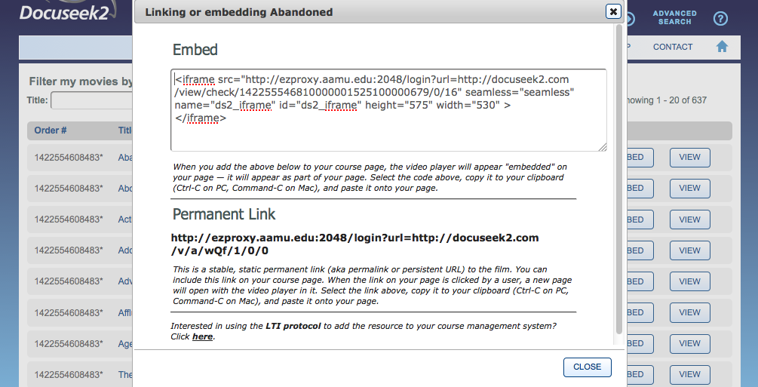

Slide 10
Usage Data
Impressions
Views
Time viewed
Overall percent viewed
Engagement
Exportable
Not COUNTER compliant

Slide 11
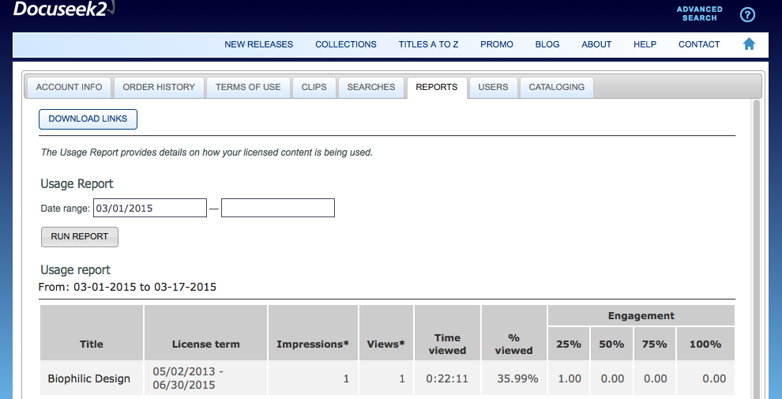

Slide 12
Additional features
Detailed film information
Advanced search tools
Closed captions: ~1/3
Closed captions or subtitled: a bit more than half
Interactive transcripts: 129 titles
Clip-making tool

Slide 13


Post sales support
Posters and postcards
Social media tools
Emailable search results
Tutorials
Webinars
Help wiki

Slide 14
Offers
Free 30-day trial
Spring 2015 sale: 10% additional titles for 30+ token orders or Evidence-Based Acquisition orders – through June 30, 2015

Slide 15
“There is simply no other documentary collection on par with Docuseek2.”
– Chris Lewis, American University
Notes:
Distinguish between a mass of content and the quality of the individual titles. Although a relatively small collection, special, even essential body of film.

