Slide 1


Academic streaming source for social issue and documentary film
With content from leading distributors
640+ titles
Streaming since 2012

Slide 2
Key features
Exclusive content
Carefully curated
Flexible licensing options
Detailed analytics
Promotional tools
High quality encoding, variable bitrate delivery, high performance distributed content delivery network
Free 30-day trial
Notes:
Distinguish between a mass of content and the quality of the individual titles. Although a relatively small collection, special, even essential body of film.

Slide 3
Renowned films
Of American University’s “See these 100 streaming documentaries before you graduate” list, 44 are from the Docuseek2 collection.
http://aulibmedia.blogspot.com/2015/03/see-these-100-streaming-documentaries.html
Notes:
Distinguish between a mass of content and the quality of the individual titles. Although a relatively small collection, special, even essential body of film.

Slide 4
Music and the Performing Arts
15 titles
Unique content
Critical analysis; unique perspectives; historical view

Slide 5

Music and the Performing Arts
Lomax the Songhunter: The story of Alan Lomax (1915-2002), who traveled the world with his recording equipment preserving a disappearing treasury of folk songs. (2014)

Slide 6

Music and the Performing Arts
Black February: Chronicles an unprecedented series of concerts performed in February 2005 by the legendary jazz composer Lawrence D. “Butch” Morris. (2012)

Slide 7
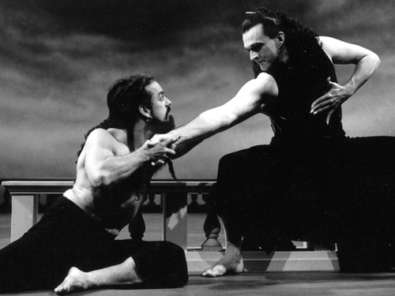
Music and the Performing Arts
Dido and Aeneas: The critically-acclaimed Mark Morris dance production of the baroque operatic masterwork. (1996)

Slide 8
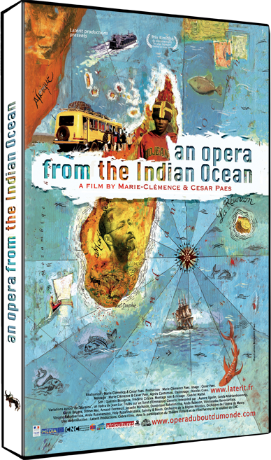
Music and the Performing Arts
An Opera from the Indian Ocean: The African descendent and Reunion born Trulès composed the opera Maraina, recounting the story of the first settlers of the Indian Ocean islands that becomes a fascinating voyage through time and space, between the 17th century seafarers ships and Madagascar today. (2013)

Slide 9

Music and the Performing Arts
Girls on the Wall: The teenage girls of Warrenville Prison are getting a shot at redemption in a most unlikely form: a musical based on their lives. As three fascinating inmates write and stage their play, they're compelled to re-live their crimes, reclaim their humanity and take a first step toward breaking free of the prison system. (2009)

Slide 10
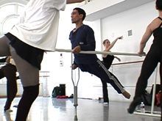
Music and the Performing Arts
Phoenix Dance: Dancer Homer Avila lost his right leg and most of his hip to cancer and thought he'd never dance again until choreographer Alonzo King challenged expectations of what it means to be 'disabled.' (2007)

Slide 11

Music and the Performing Arts
Acting Blind: Takes audiences behind the scenes as a company of non-professional actors rehearse a play about life without sight. The performers have no problem imagining themselves in these roles: they are blind themselves. (2006)

Slide 12

Music and the Performing Arts
From Nothing, Something: Profiles creative thinkers across a variety of disciplines to find the common techniques, habits and neuroses that lead to breakthrough ideas. (2011)

Slide 13
Music and the Performing Arts
Also of note:
Advertising Missionaries: Follows the mission of one theater company to bring the consumer revolution to the people of the highlands of Papua New Guinea.
Beethoven’s Hair: Traces the journey of a lock of Beethoven's hair, culminating in the scientific analysis that reveals Beethoven's medical secret.
The Internationale: Draws on people's stories of an emotionally charged radical song (the long-time anthem of socialism and communism) to celebrate the relationship between music and social change.
And more…

Slide 14
“There is simply no other documentary collection on par with Docuseek2.”
– Chris Lewis, American University
Notes:
Distinguish between a mass of content and the quality of the individual titles. Although a relatively small collection, special, even essential body of film.

